Slide 1
API & Shader Debugging
3DCC DAY2

Slide 2


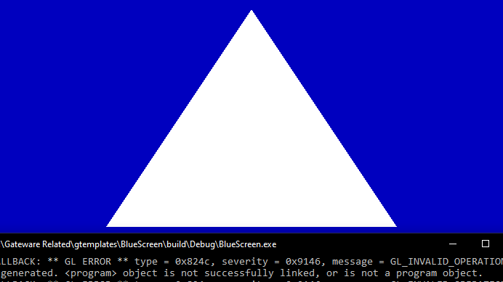
DEMO: Where is the debug output?

Slide 3

DEMO: LETS USE RENDERDOC

Slide 4

COMMON API AGNOSTIC PITFALLS

Slide 5
IGNORING THE CONSOLE/OUTPUT WINDOW
If you can’t figure out what an error means, that doesn’t mean you should ignore it. Its ok to ask each other what they mean!
Eventually you will begin to understand them, but until then web search and discussion will help! (ask in our Discord channel)
This doesn’t mean people can fix your code for you, we can just help you understand what is wrong so YOU can fix it.

Slide 6
SHADERS DEFAULT TO COLUMN MAJOR MATRICIES
If everything seems right but nothing shows up this could be why.
Many CPU math libraries are ROW MAJOR. (ex: Gateware, DirectXMath)
This means after you send a matrix to the GPU everything gets mixed up.
There are three common solutions:
Use special commands in the shader language to switch them to ROW MAJOR.
Mathematically Transpose a copy of your matrix data before you send it.
Reverse the order or multiplication in the shader. (Ex: Projection * View * World * pos)

Slide 7


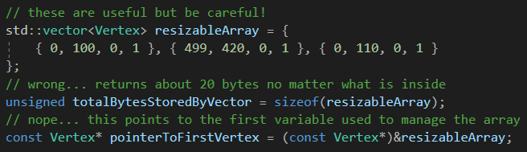
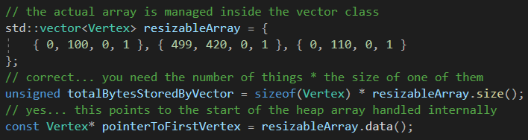
Incorrect use of STD library VECTOR class
At some point you're probably going to want to use std::vector for data.
It’s a useful and convenient data structure if you understand how it works.
A std::vector is NOT an array. An std::vector MANAGES a resizable array.
If you treat your std::vector like its a raw array, you will run into problems!

Slide 8
POTENTIAL OPENGL SPECIFIC issues
No Debuggable Shaders. ☹ (In RenderDoc anyway)
Using Right-Handed coordinates on Left-Handed Data.
Reversed matrix multiply order for column major GLSL shaders.
Not taking flipped V(uv) coordinates into account from 3D models.
By Default, OpenGL does back-face culling on Clockwise Triangles!

Slide 9
Resources & Examples
Video recording of how to use RenderDoc.
Passcode: BndU%3u0
RenderDoc is great but it is not your only option!
Did you know you can Analyze your Steam collection?

Slide 10
Q

